Slide 1
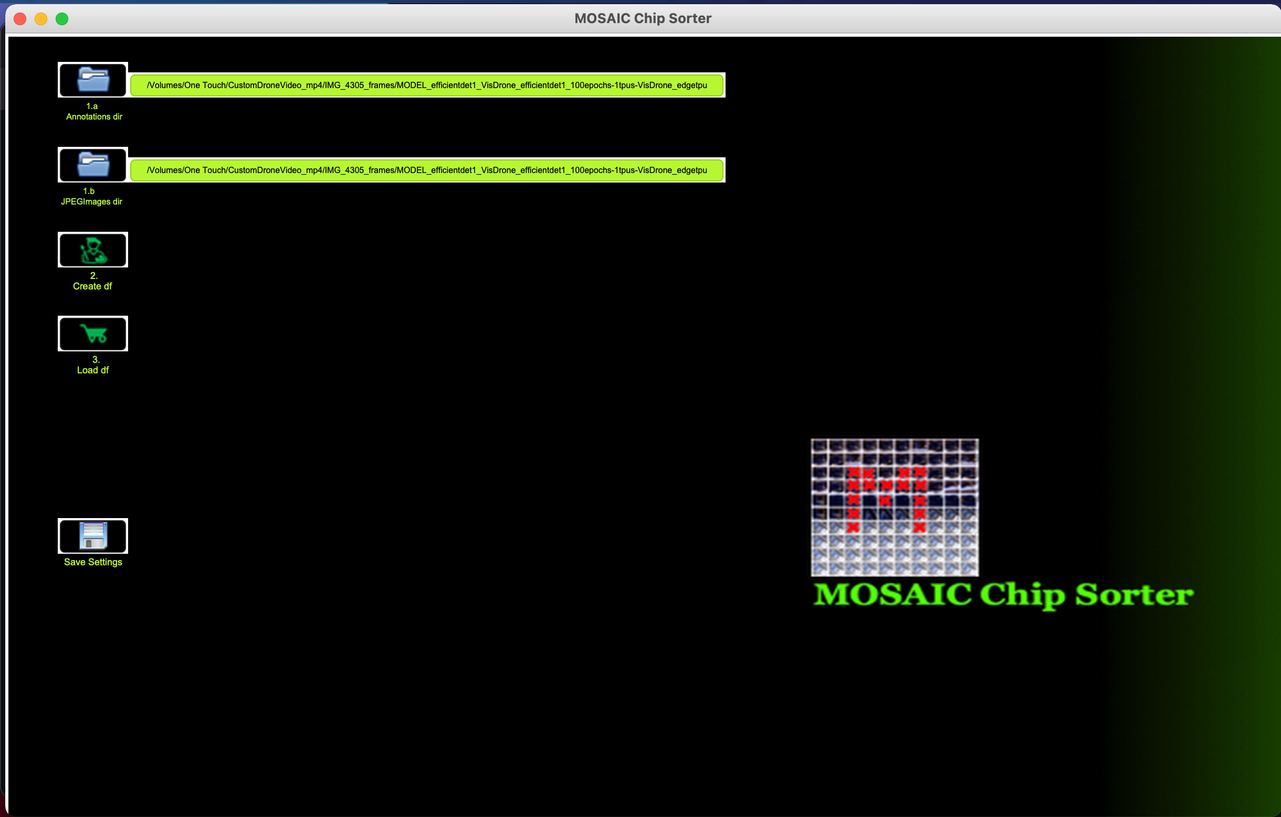
1. Find Annotation & JPEG Images directories.

Slide 2
2. Create Pandas DataFrame of those Annotation & JPEG Images.

Slide 3
3. Load Pandas DataFrame of those Annotation & JPEG Images.

Slide 4
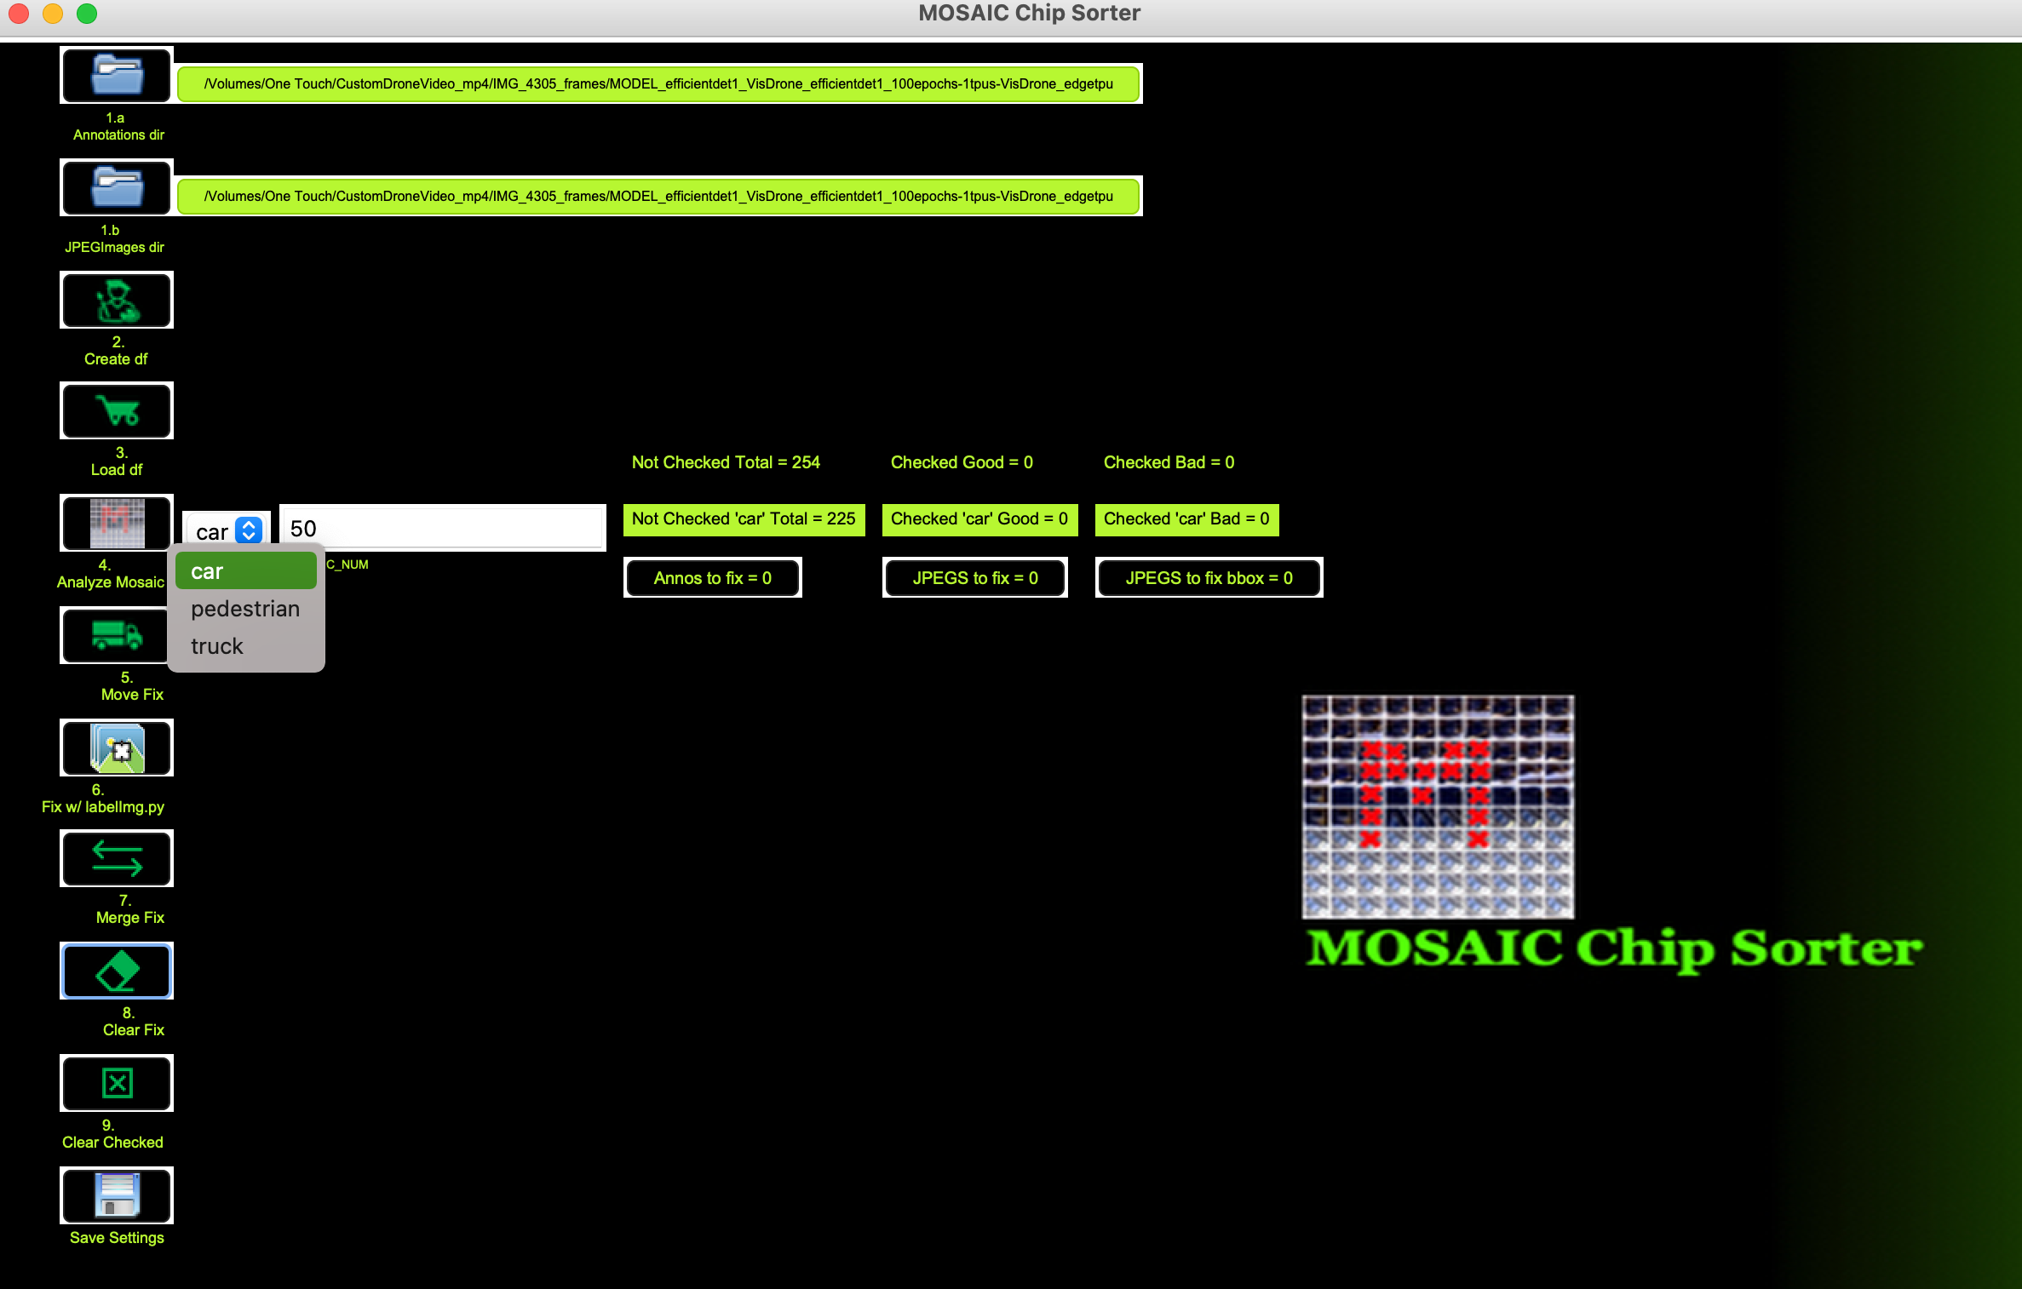
4.a Select target id to create MOSAICs.

Slide 5
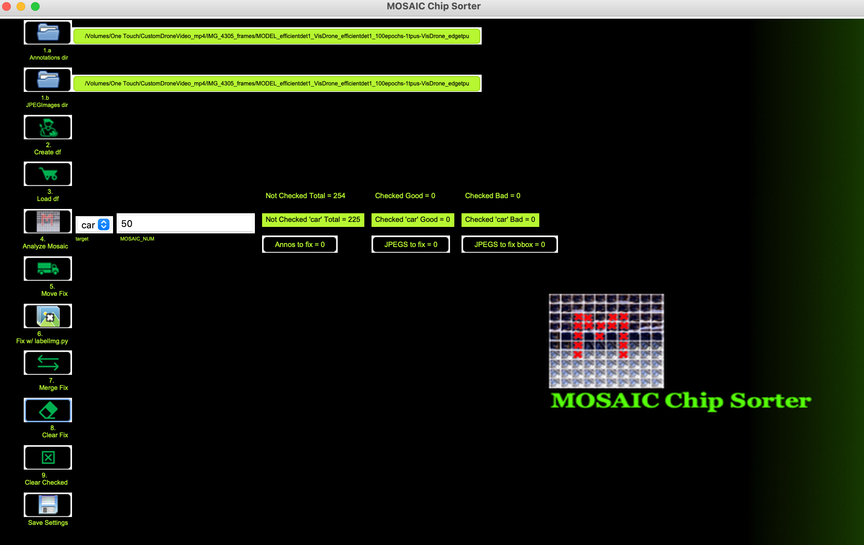
4.b Enter number of chips per MOSAIC.

Slide 6
4.c Analyze MOSAIC.

Slide 7
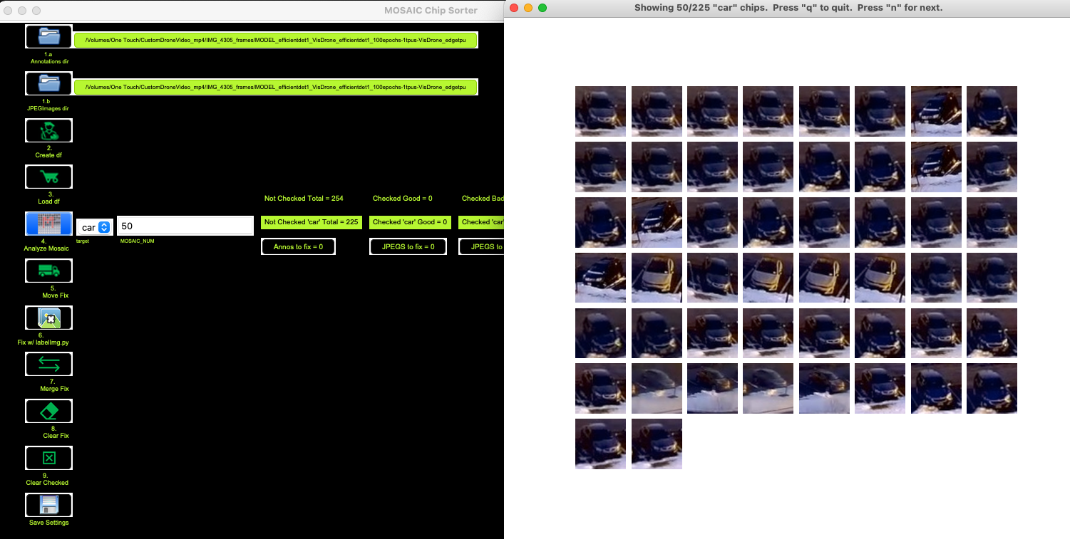
4.d Press “n” if all looks good per MOSAIC PAGE.

Slide 8
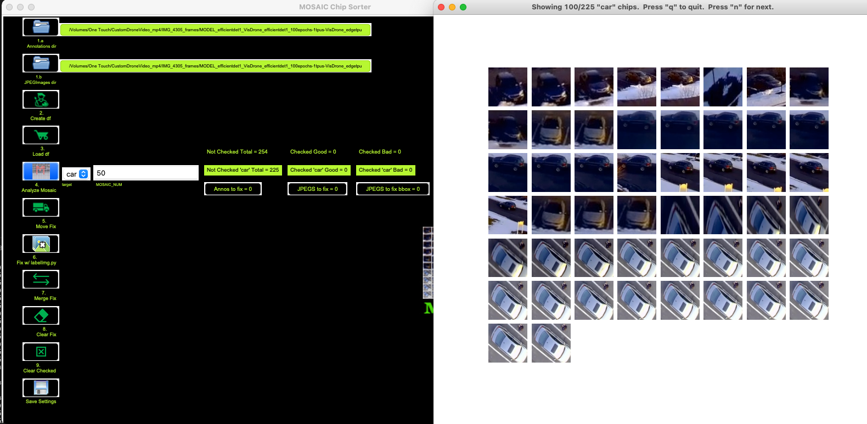
4.e Single click on chip that looks ”bad”. If the wrong chip is selected, double click it.

Slide 9
4.f Press “q” when finished looking.

Slide 10
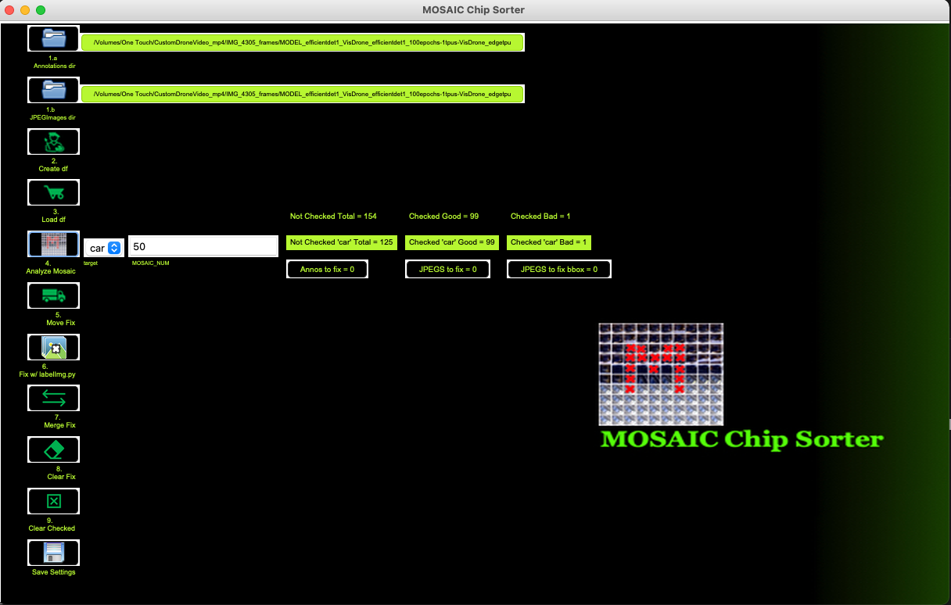
4.g Verify the number you checked and have left.

Slide 11
5.a Move the files to fix to a temporary directory.

Slide 12

5.b Notice the update shows the single “bad” file to fix was moved.

Slide 13
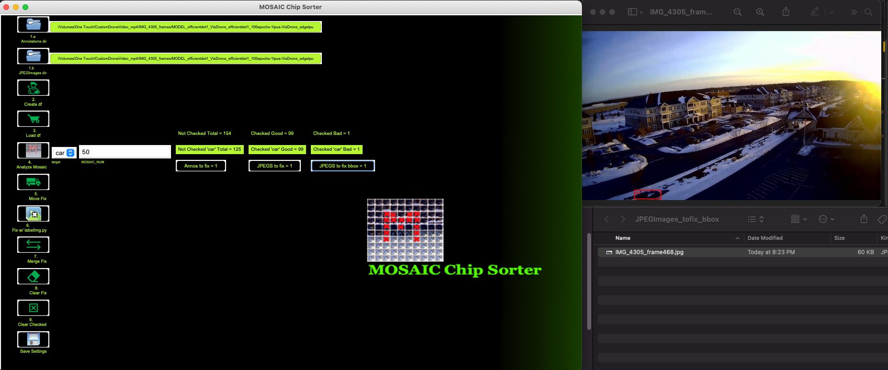
5.c Inspect the JPEGImage to fix bbox file.

Slide 14
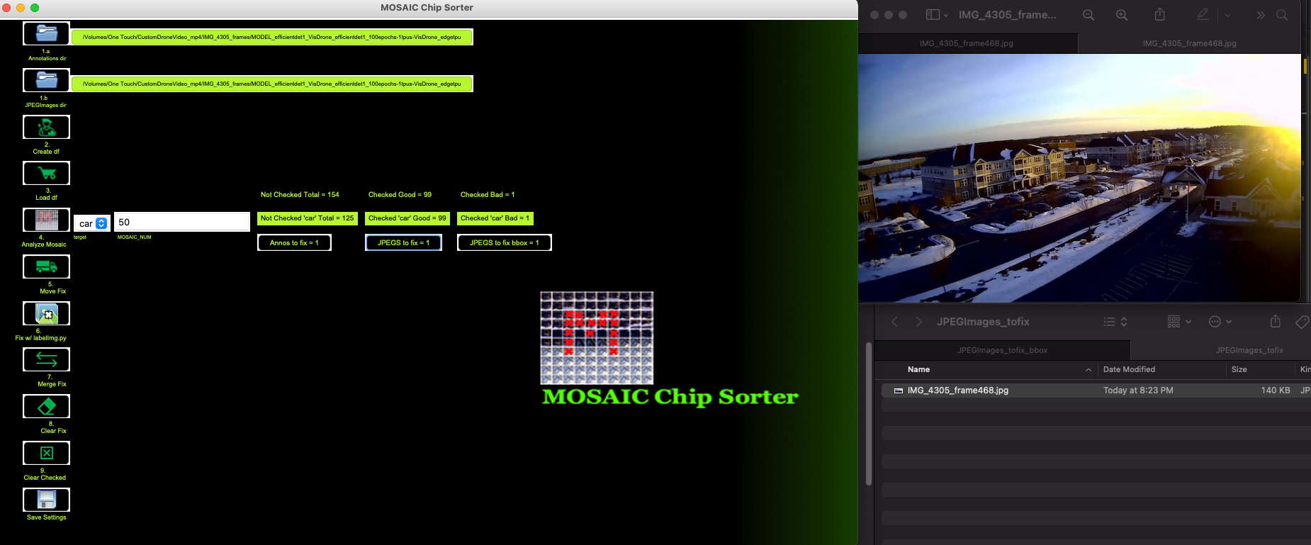
5.d Inspect the JPEGImage.

Slide 15
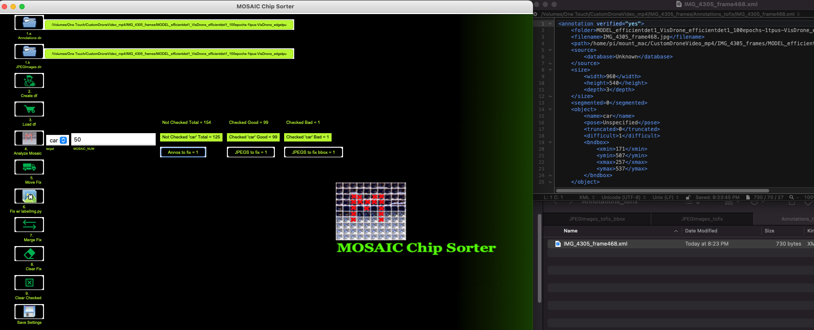
5.e Inspect the Annotation file to fix.

Slide 16
6.a Open the files to fix with labelImg.py.

Slide 17
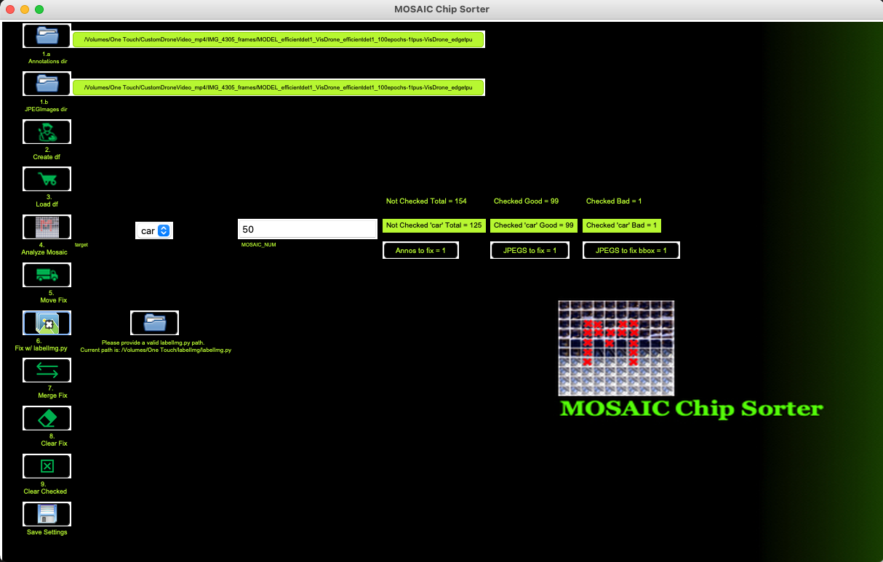
6.b Point to path of your labelImg.py.

Slide 18
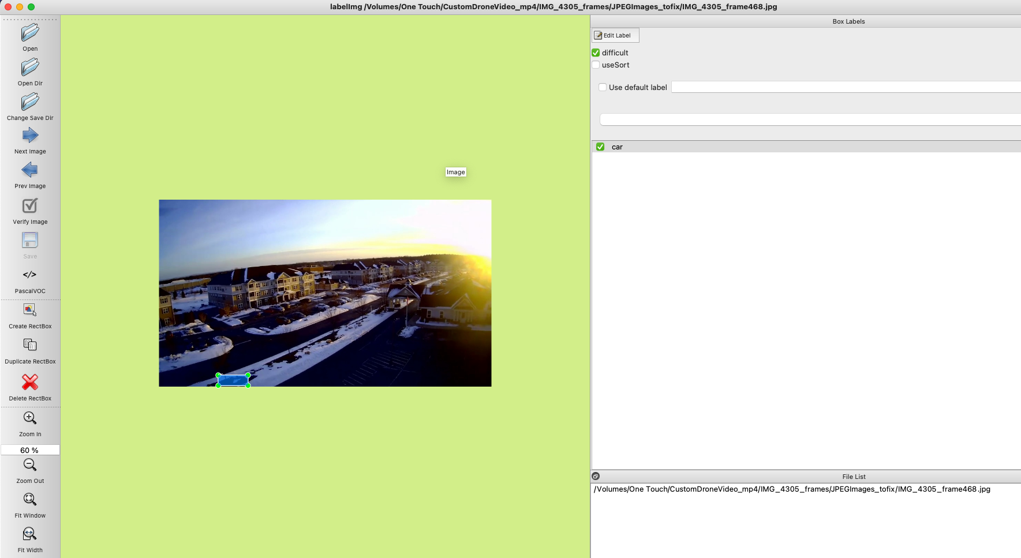
6.c Delete the bad box in this case.

Slide 19
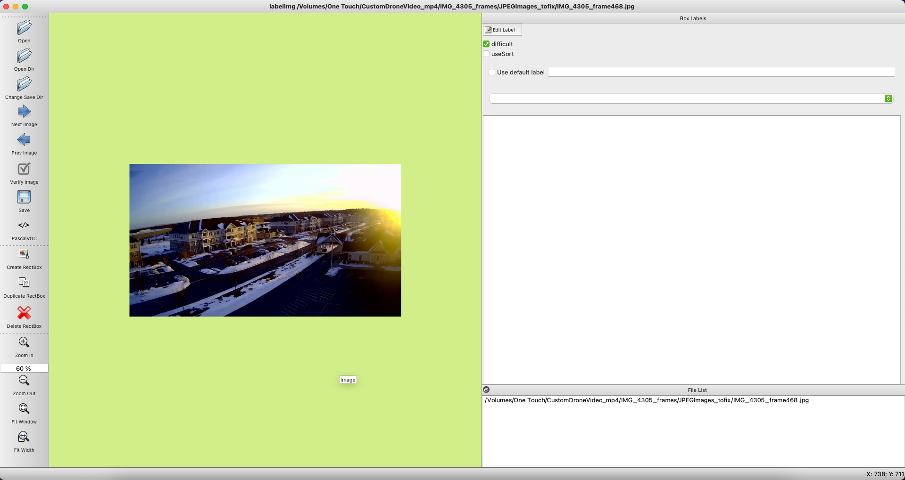
6.d Save.

Slide 20
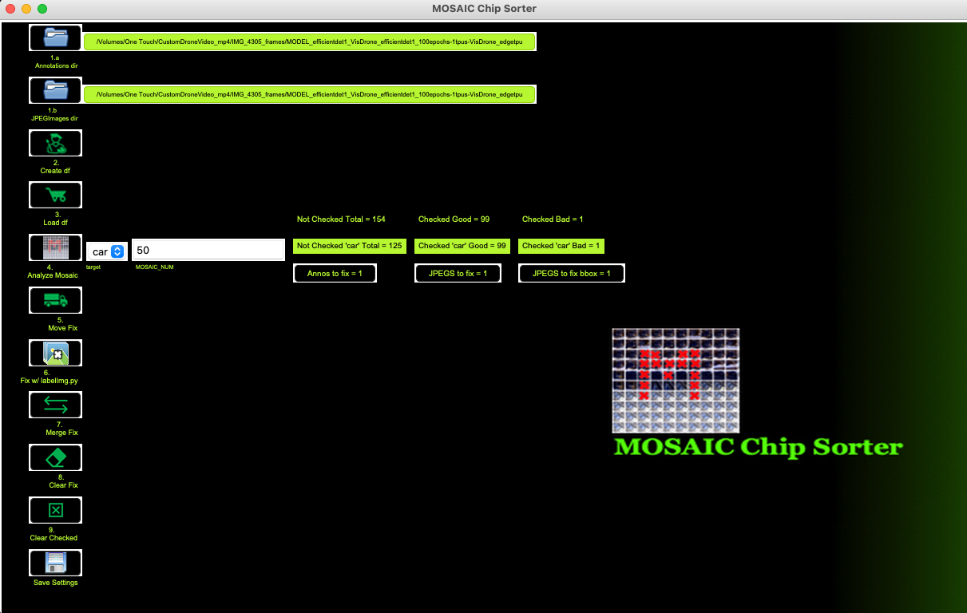
7.a Merge the fixes made to your original directories of Annotations/JPEGs.

Slide 21
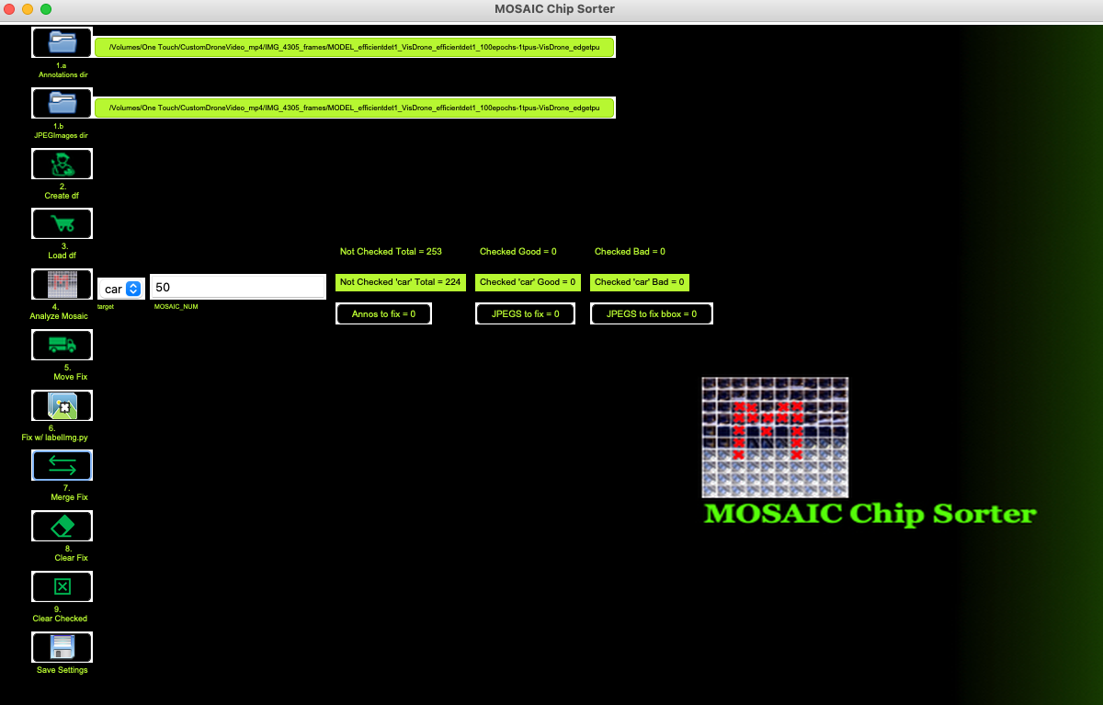
7.b Notice everything is reset now and that chip will no longer show.

